Slide 1
How-To Ungroup Table in PowerPoint

Slide 2
Column 1 | Column 2 | Column 3 | Column 4 | Column 5 | Column 6
Item 1 | Item | Item | Item | Item | Item
Item | Item | Item | Item | Item | Item
Item | Item | Item | Item | Item | Item
Item | Item | Item | Item | Item | Item
Item | Item | Item | Item | Item | Item
Item | Item | Item | Item | Item | Item
Item | Item | Item | Item | Item | Item
Select the table and CTRL+X to cut

Slide 3
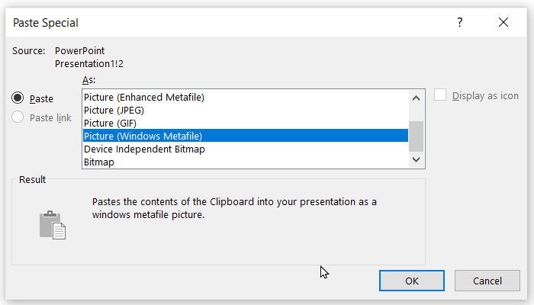
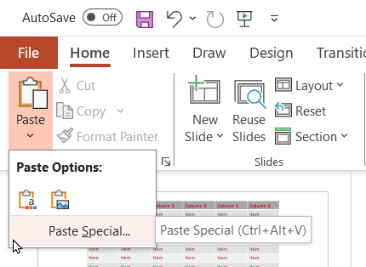
From the Home tab, click Paste —> Paste Special
Select Picture (Windows Metafile). Click ok

Slide 4
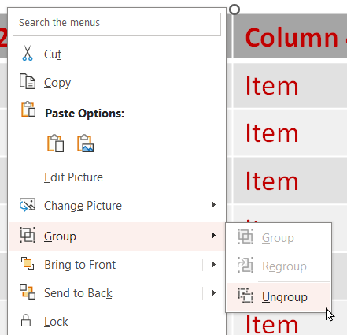
Select the table, right click then click Group —> Ungroup. Do this twice

Slide 5
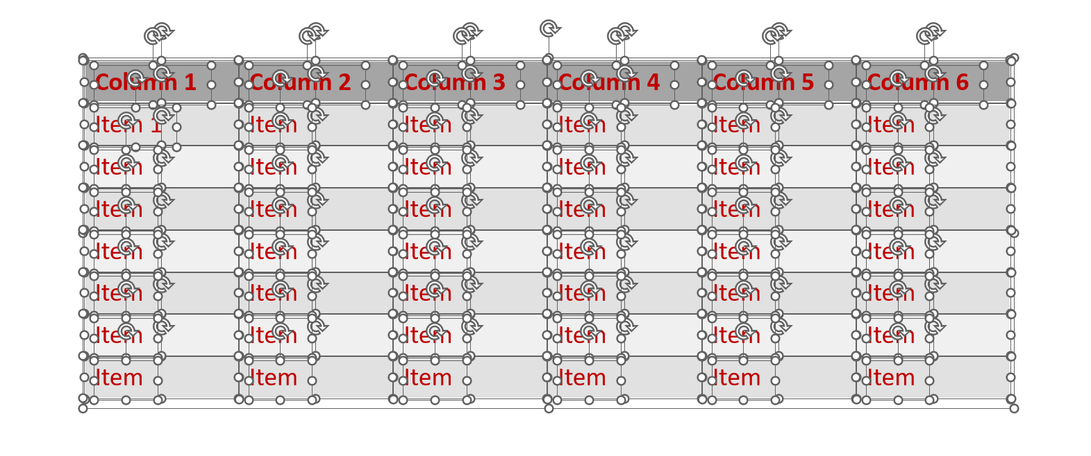
Select the table, right click then click Group —> Ungroup. Do this twice

